Slide 1




Campus Canteen Feedback Application (CCF)
DIT1334 Object-Oriented Development
PRESENT BY:
TE CHONG YI (SCSJ2400992)
CHEW ZHI XIANG (SCSJ2500184)
SAM LAI JIA XIAN (SCSJ2500239)

Slide 2

Project Overview & Problem Statement
1. Application Goal:
2. Pain Point:
To systematically collect student evaluations (ratings, tags) and generate data analytics for canteen management
Existing methods (verbal/paper forms) are fragmented, inconsistent, and lack structure, leading to an inability to analyze student preferences
02

Slide 3
SMART Objectives & Target Users
SMART Example (Focus):
Target Users (PACT):
Primary Users are Students (submitting feedback), and Secondary Users are Cafeteria Managers (reviewing charts)
Establish a structured mobile platform to achieve a minimum of 10 valid feedback submissions within the first month of deployment.
04

Slide 4
Student Input:
Login/register information; Dish name, rating, tags, comment; Photo (optional) .
Initial Analysis: IPO & FlowChart
Flowchart Logic:
Application starts with Splash screen, followed by Display selection screen (Login/Register/Guest).
Student Process:
Validate identity; Store feedback in database; Categorize and analyze data .
04

Slide 5
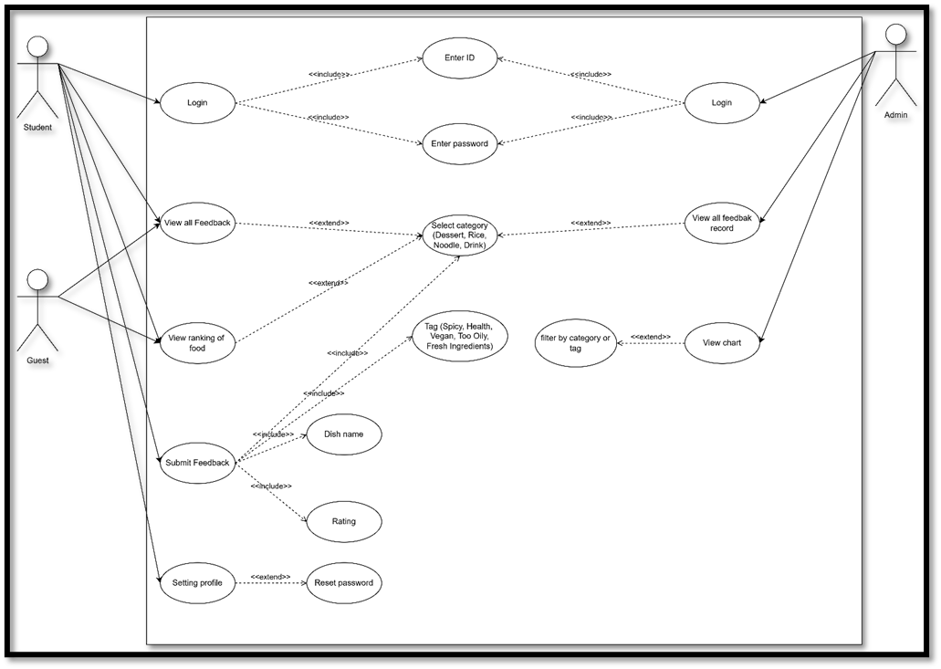
Use Case Diagram
05

Slide 6


OOP Focus 1: Encapsulation
Principle:
Security:
Validation:
We strictly applied the principle of encapsulation to protect core data
The password field in the User entity stores the BCrypt hash value generated by PasswordUtility.hashPassword()
PasswordUtility.verifyPassword() encapsulates the verification logic, ensuring the security of sensitive user information.

Slide 7
Principle:
OOP Focus 2: Abstraction (DAO Layer)
Abstraction is applied in the data persistence layer, hiding complex implementation details .
UserDao Interface:
Defines abstract operations such as insert(User user) and query methods (e.g., findByUserTypeAndUserid) .
09

Slide 8
OOP Focus 2: Abstraction (Repository Layer)
UserRepository:
Provides a unified interface uploadUser(User user) .This separates local database operations (db.userDao().insert(user)) from Firebase upload operations (userRepo.uploadUser(user)), abstracting the data persistence logic.
09

Slide 9
Authentication (Login):
Provides role-based access options (Student / Admin).
Key Feature: User Authentication & Roles
Registration:
Collects necessary user identity information, including full name, student ID, and password.
Validation:
Implementation includes strict password complexity checks and profanity filtering for name fields
08

Slide 10
Submission Form:
Fields include Dish Name, Photo (optional), Category selection, 5-star Rating, and Text Comment
Key Feature: Feedback Submission & Listing
Home Page Listing:
  Includes dynamic search functionality.
  Features filters (e.g., All Categories) and sorting tools.
08

Slide 11
My areas of expertise
Usability Testing Summary
Methodology:
Positive Feedback:
Negative Feedback :
Testing was conducted to assess the user-friendliness of the application.
Application was deemed "very easy to use" and page design was "user-friendly".
  Users reported the Missing On-Screen 'Back' Button was "very inconvenient".
12

Slide 12

Conclusion & Reflection
Design Consistency:
IPO analysis, Flowchart, and UML diagrams acted as the blueprints, ensuring the final code strictly adhered to the initial design.
OOP Challenges:
The main challenge was applying Abstraction and Encapsulation in Java, specifically determining which variables required strict privacy and implementing the Repository pattern.
14

Slide 13
Thank You !
15

